Slide 1
CS 513
Knowledge Discovery And Data Mining - Project
Bankruptcy Prediction Analysis
1. Preet Jhanglani, CWID: 10474322 Section A
2. Girish Budhrani, CWID: 10477624 Section A
3. Anirudh Jeevan, CWID : 10475896 Section A
4. Surya Giri, CWID : 10475010 Section B

Slide 2
ABSTRACT
The dataset chosen for this project is Company Bankruptcy Prediction, from Kaggle. The data were collected from the Taiwan Economic Journal for the years 1999 to 2009
Company bankruptcy was defined based on the business regulations of the Taiwan Stock Exchange. The problem pertaining to this dataset is to find whether a company (represented by rows) is on the verge of Bankruptcy (outcome: 1) or not (outcome: 0).
The dataset has 96 columns and 6819 instances
Link to the dataset : https://www.kaggle.com/fedesoriano/company-bankruptcy-prediction

Slide 3
Problem
Choose a dataset which has 2 class labels, i.e., Classification Problem.
The number of input features should atleast be 12 to 15, excluding output class label column
Classification model should include data mining algorithm covered in the curriculum
Finally, get it approved

Slide 4
Our dataset
The dataset chosen for this project is Company Bankruptcy Prediction, from Kaggle. The data were collected from the Taiwan Economic Journal for the years 1999 to 2009
Company bankruptcy was defined based on the business regulations of the Taiwan Stock Exchange. The problem pertaining to this dataset is to find whether a company (represented by rows) is on the verge of Bankruptcy (outcome: 1) or not (outcome: 0)
The dataset has 96 columns and 6819 instances
Link to the dataset : https://www.kaggle.com/fedesoriano/company-bankruptcy-prediction

Slide 5
Exploratory Data Analysis
We used all the 96 features to train our model on various Classification Models. Why all? Good question.
We found the mean, max, min of each of the columns in the dataset
When we checked for missing values, the dataset didn’t have any missing values
We normalized the data and split the data into training and testing
We choose 75% for training and 25% for Testing

Slide 6
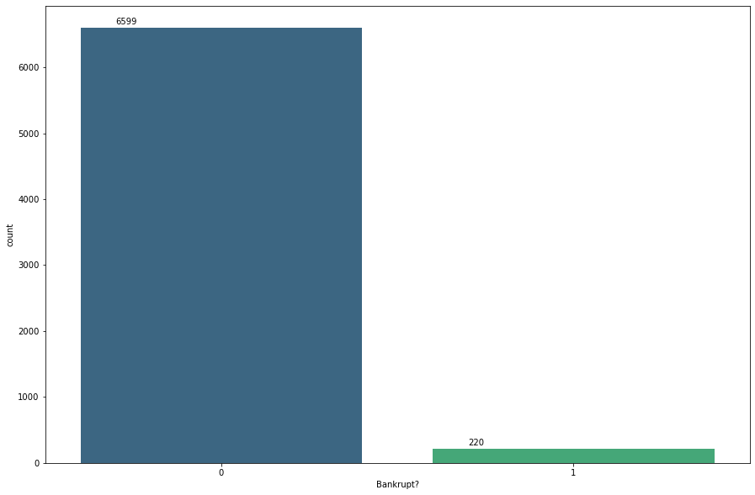
NO: 6599
YES: 220
Count-plot Of Bankruptcy

Slide 7

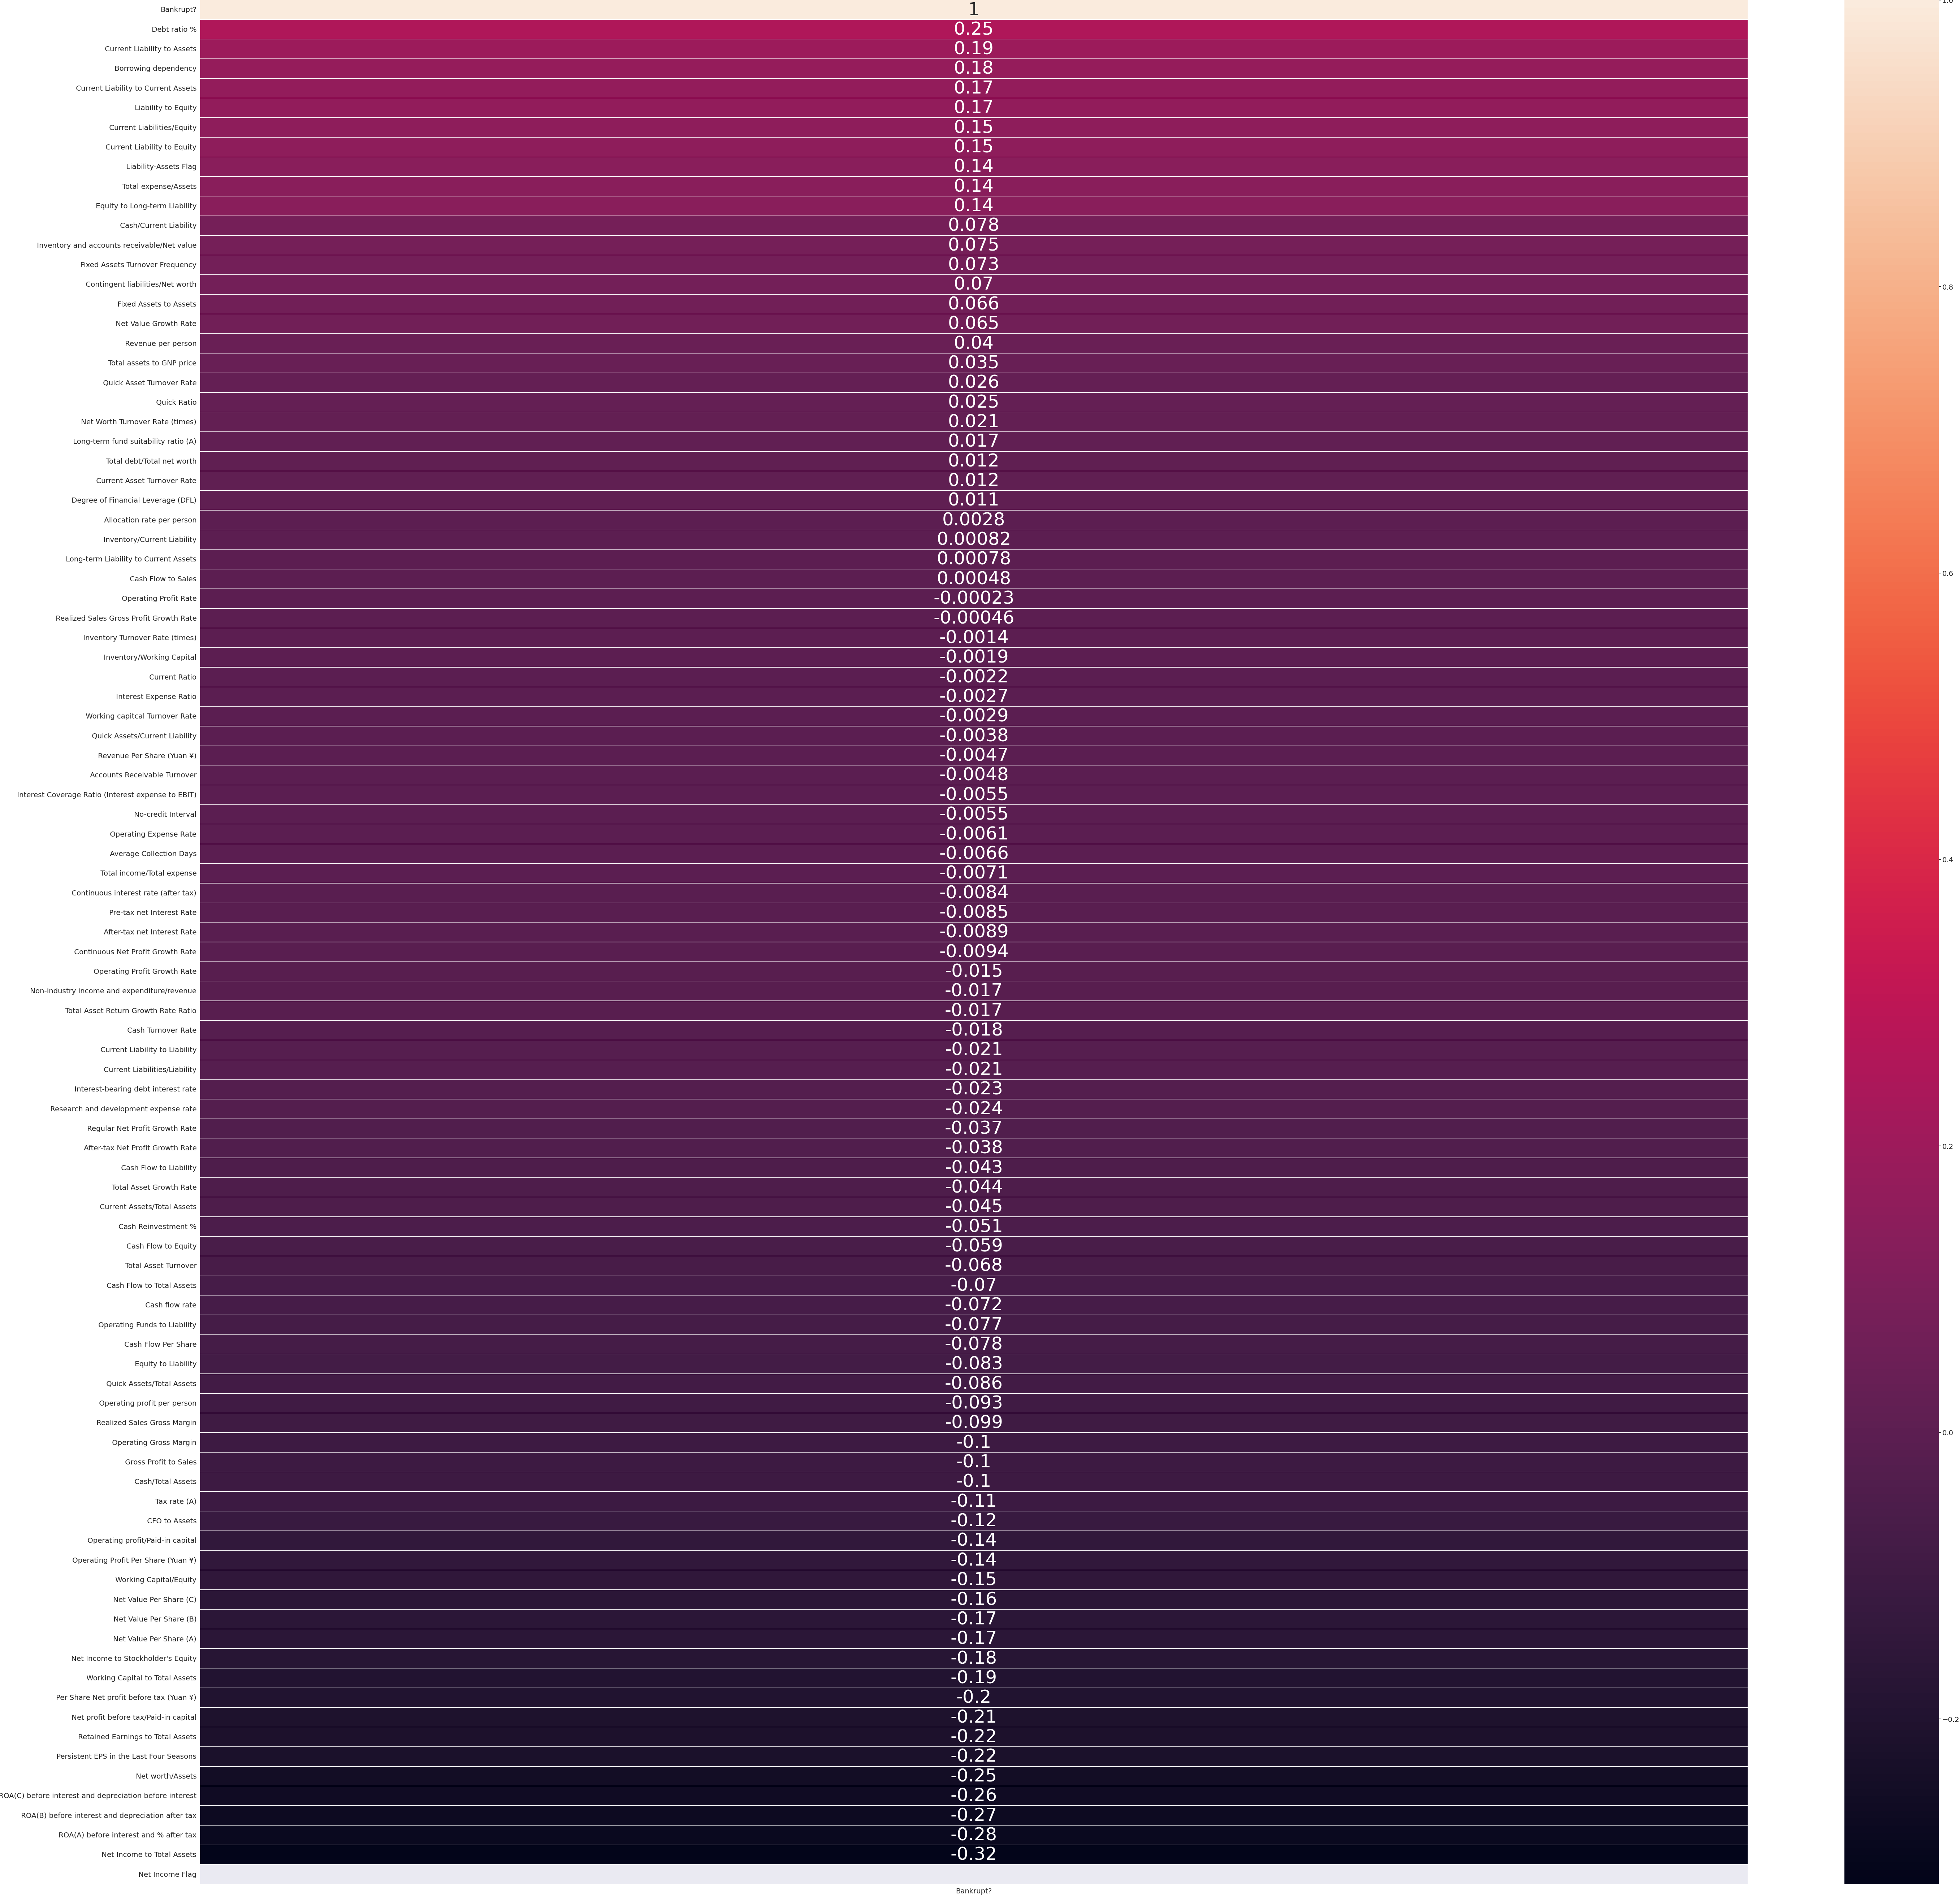
Heatmap Showing Bankruptcy V/S all the features

Slide 8
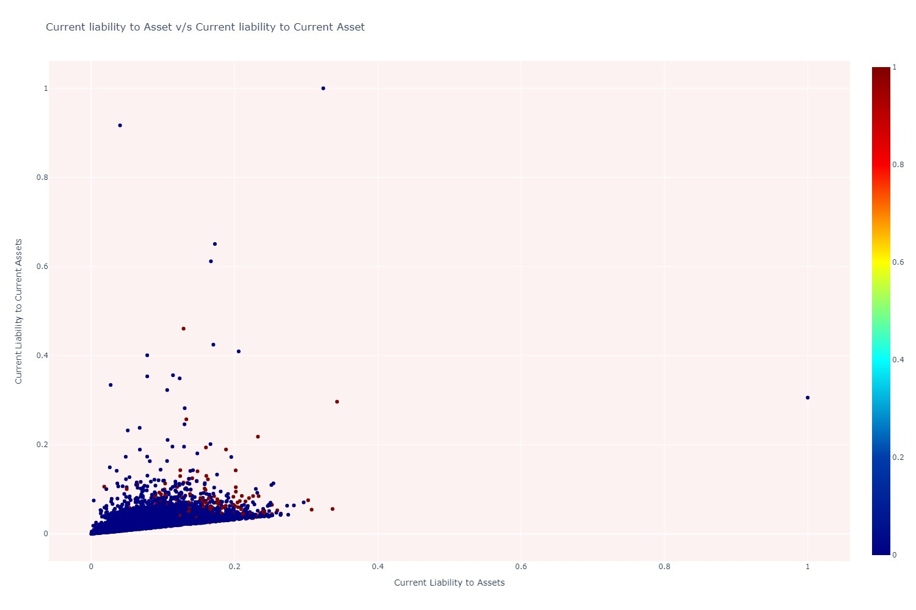

Slide 9
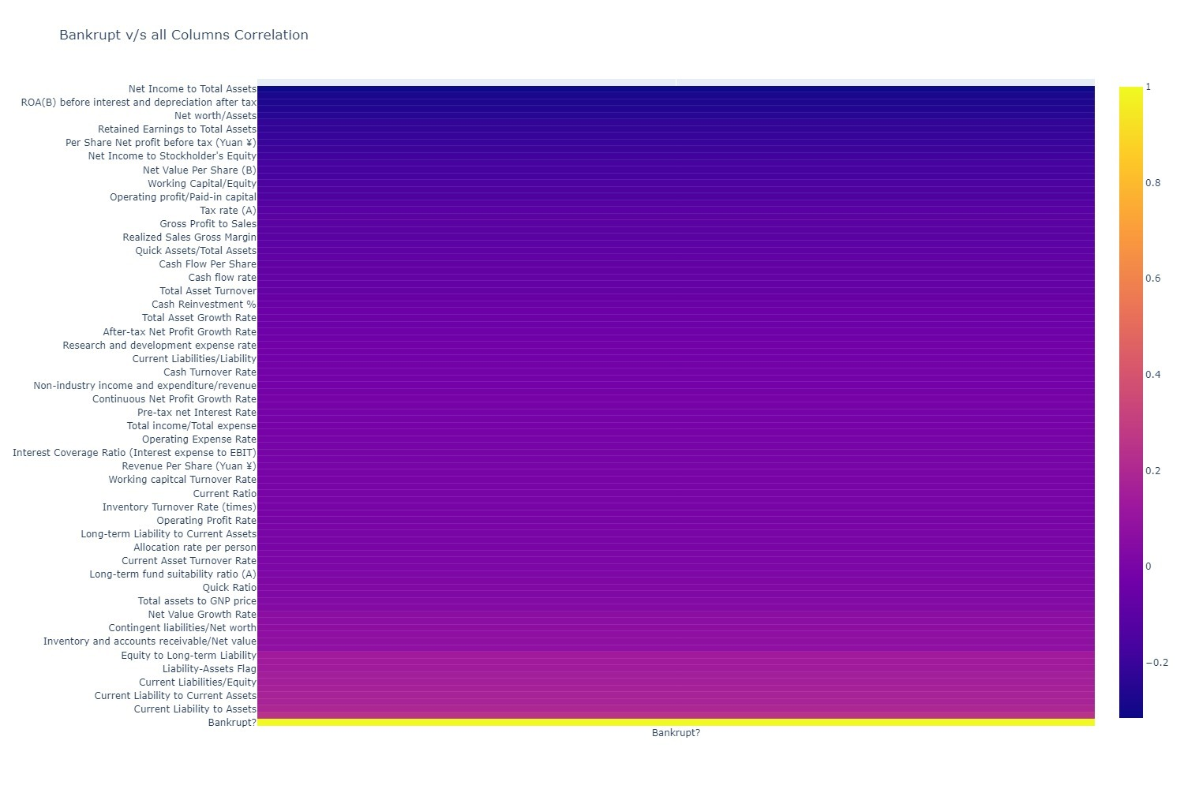

Slide 10
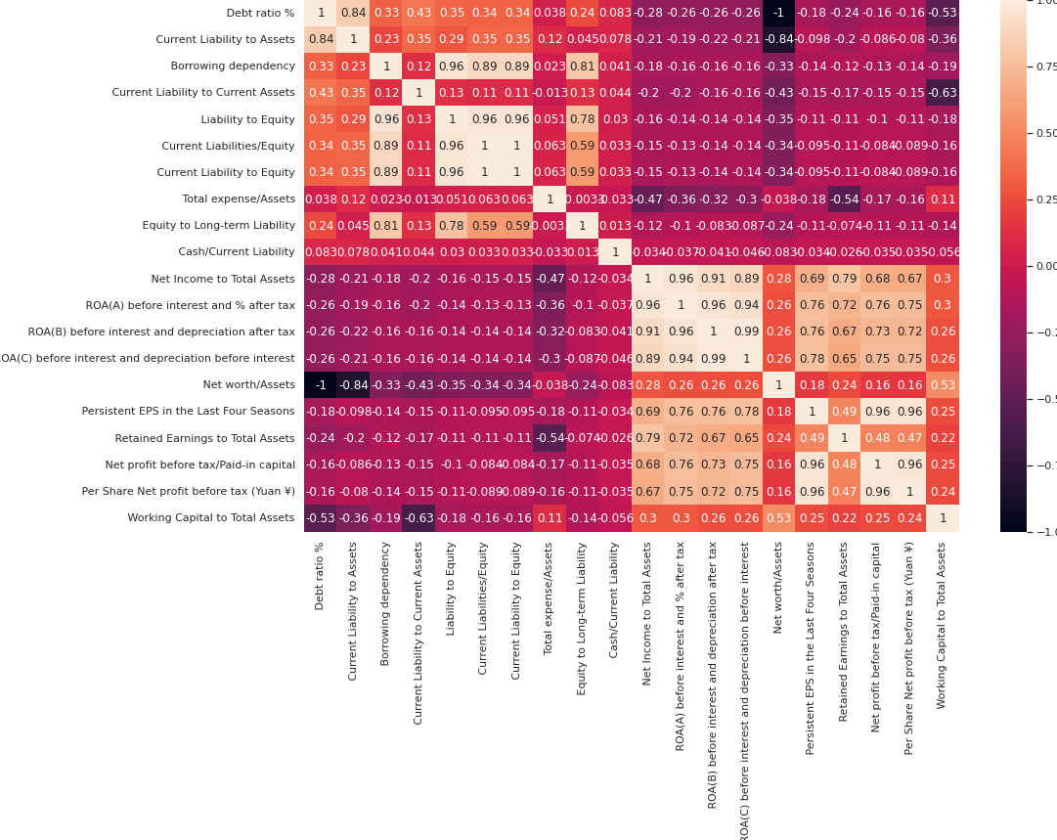
Heat Map of the top 10 co-relations

Slide 11
Classification Algorithms

Slide 12
Logistic REGRESSION
Logistic regression is a statistical model that in its basic form uses a logistic function to model a binary dependent variable, although many more complex extensions exist.
The accuracy of Logisitc Regression is 96.95014662756598%
This is the confusion matrix
 | NO | YES
NO | 1641 | 12
YES | 40 | 12

Slide 13
DECSION TREE
A decision tree is a flowchart-like structure in which each internal node represents a "test" on an attribute (e.g. whether a coin flip comes up heads or tails), each branch represents the outcome of the test, and each leaf node represents a class label (decision taken after computing all attributes). The paths from root to leaf represent classification rules.
The accuracy of Decsion Tree is 95.48387096774194%
This is the confusion matrix
 | NO | YES
NO | 1617 | 36
YES | 41 | 11

Slide 14
KNN
k-NN is a type of classification where the function is only approximated locally and all computation is deferred until function evaluation.
The accuracy of KNN is 96.95%
This is the confusion matrix
 | NO | YES
NO | 1648 | 5
YES | 47 | 5

Slide 15
Naïve bayes
Naive Bayes classifiers are a family of simple "probabilistic classifiers" based on applying Bayes' theorem with strong (naïve) independence assumptions between the features.
The accuracy of Naïve Bayes is 69.38%
This is the confusion matrix
 | NO | YES
NO | 475 | 1178
YES | 5 | 47

Slide 16
Support vector machine
Support Vector Machine (SVM) is a supervised machine learning algorithm capable of performing classification, regression and even outlier detection. The linear SVM classifier works by drawing a straight line between two classes.
The accuracy of Support Vector Machine is 97.00879765395894%
This is the confusion matrix
 | NO | YES
NO | 1649 | 4
YES | 47 | 5

Slide 17
RANDOM Forest
Random forests or random decision forests are an ensemble learning method for classification, regression and other tasks that operates by constructing a multitude of decision trees at training time.
The accuracy of Random Forest is 96.59824046920821%
This is the confusion matrix
 | NO | YES
NO | 1639 | 14
YES | 44 | 8

Slide 18
GRADIENT BOOSTINNG
Gradient boosting is a machine learning technique which produces a prediction model which is in the form of an ensemble of weaker prediction models (which are typically deicision trees).
The accuracy of gradient boosting is 96.89149560117302%
This is the confusion matrix
 | NO | YES
NO | 1645 | 8
YES | 45 | 7

Slide 19
NEURAL NET
A neural network is a network or circuit of neurons, or in a modern sense, an artificial neural network, composed of artificial neurons or nodes. Thus a neural network is either a biological neural network, made up of biological neurons, or an artificial neural network, for solving artificial intelligence problems.
The accuracy of neural net is 96.95%
This is the confusion matrix
 | NO | YES
NO | 1653 | 0
YES | 52 | 0

Slide 20
XG BOOST RANDOM FOREST ENSEMBLE
Random forest is a simpler algorithm than gradient boosting. The XGBoost library allows the models to be trained in a way that repurposes and harnesses the computational efficiencies implemented in the library for training random forest models.
XGBoost provides an efficient implementation of gradient boosting that can be configured to train random forest ensembles.
The accuracy of this model is 96.7741935483871%
This is the confusion matrix
 | NO | YES
NO | 1639 | 14
YES | 41 | 11

Slide 21
Comparison of all the models

Slide 22
conclusion
After executing and analyzing various classification models on the given dataset, we found that Support Vector Machines gives the best classification results., with an accuracy of about 97% (97.00879765395894% to be precise), as compared to 96% or less with other methods.
We also did not need to perform any dimensionality reduction procedures as we had thought, thanks to the reliability and quality of the dataset.
Some common dimensionality reduction techniques are: Principal Component Analysis (PCA), Factor Analysis (FA), Random Projection etc.

